Slide 1
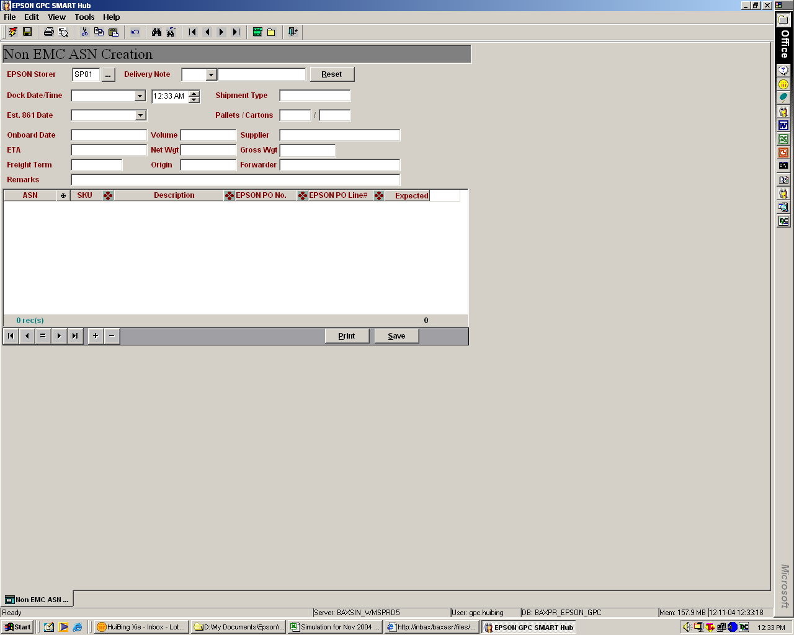
To populate the Epson manufacturing SKU. Information can be extracted from Epson 850 message.

